Slide 1
Alpha 2 Part 1 review (Chrome)
03/04/2014

Slide 2
Basics

Slide 3
Remember me at login don’t work
Delete empty folder don’t work on vault
Move feature disapeared
Album carrousel: Closing preview not working well
Invitations with several users: gmail, yopmail, yahoo, hotmail, sfr.fr, free
Album: Edit chapter can’t be back from edit
Album summary filter: Flicker before making filter, also when click on select arrow
Dashboard upload is long (Not suing cache ?)
Vault: xMB of 2GB available…2GB never change !
Library: Rename shelf use « Add Shelf » message in its popup. Should be « RENAME SHELF » for EN and « RENOMMER ÉTAGÈRE » for FR
Getlinkavie.com => « blog » redirects to blog.linkavie.com and not blog.linkavie.com/fr or /en as it should be
+ many Fench accents lost (maybe encoding issue ?)

Slide 4
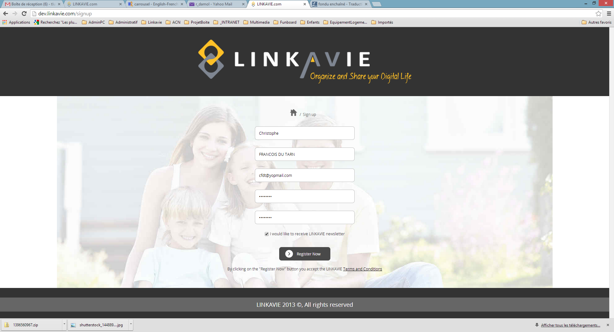
Registration
Prio 1: Registration to Mailchimp newsletter is broken both
FR and EN
Remove tagline / No tagline
“Newsletters” with a “s” at the end and capital “N” to begin

Slide 5
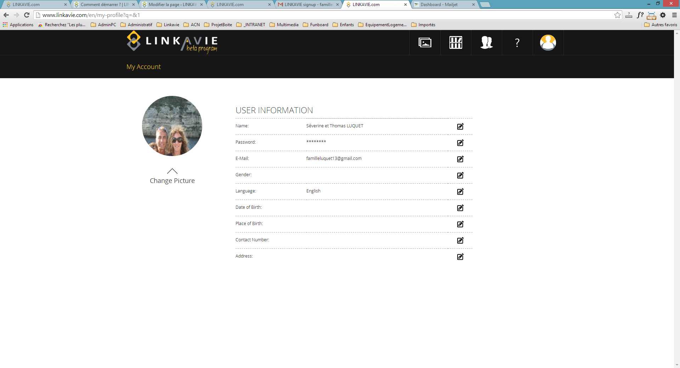
My profile
When changing photo profile, Not updated automatically. Need to make a refresh
Prio 1: A french user gets recorded as English in his profile by default. So by default, french user should be french in his profile
When changing usr language in profile, when validate, page site should change to the right language right away. Now, need to logout/login

Slide 6
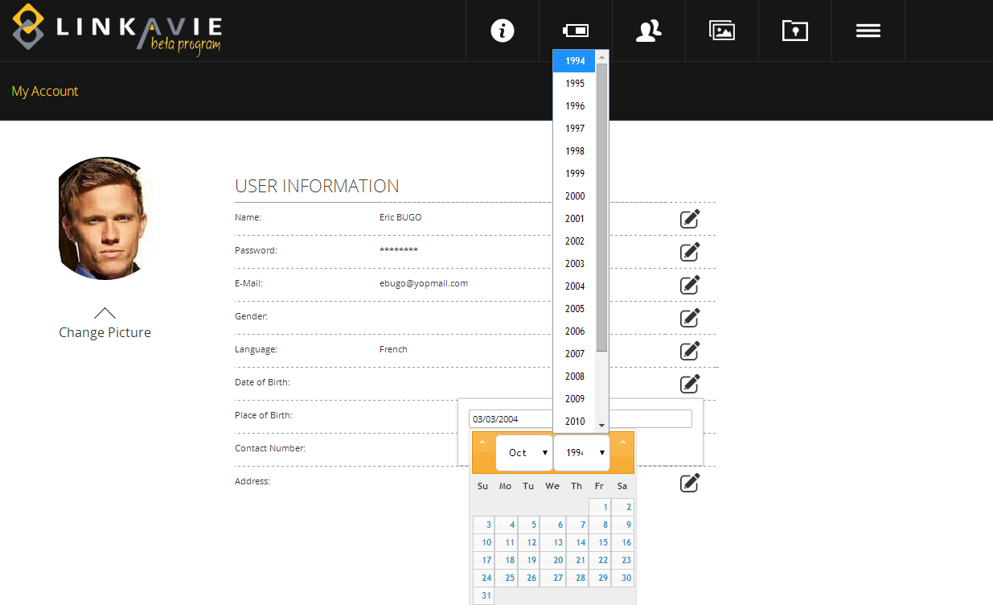
Profile
Difficult to understand how to navigate
User should be able to scroll from 1920 up to now

Slide 7
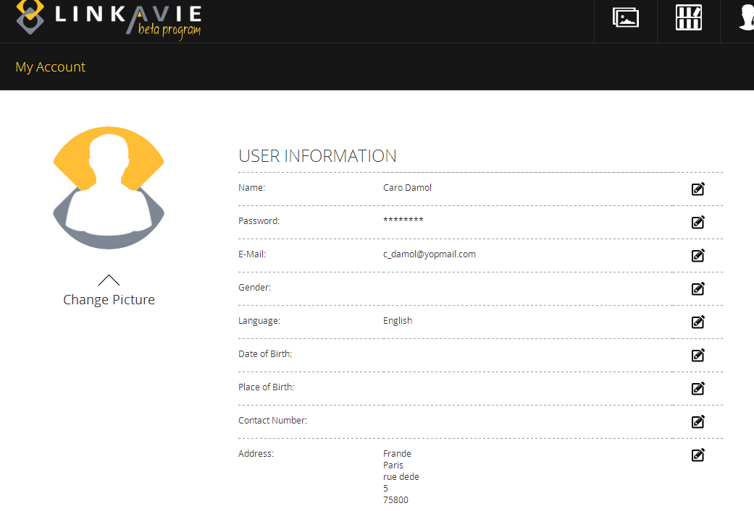
Profile
Should show the items in the following order:
Number
Street
Zip_code
Cisty
Country

Slide 8
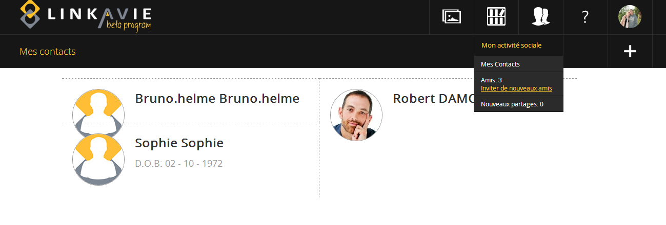
Contacts
When on My contacts page: link « My contact – invite new contact » don’t work
Should popup to invite user window
Put user email address by default
Can’t understand D.O.B. Change to “Birthday” for EN and “Date d’anniversaire” for FR
Visual is a bit broken when we have pre-registered users
To check: That a pre-registered user that don’t update his profile within 5 days get removed

Slide 9
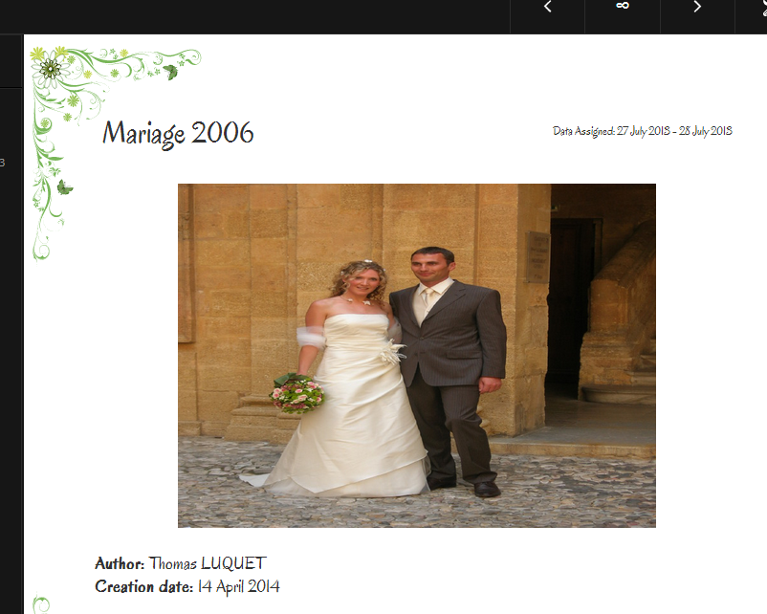
Album: Cover page
Cover: a vertical picture get transformed badly

Slide 10
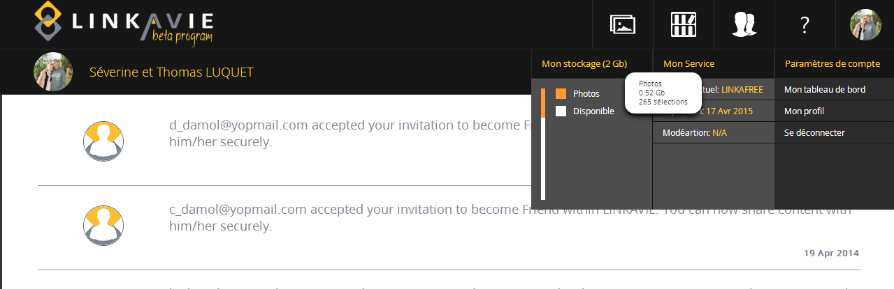
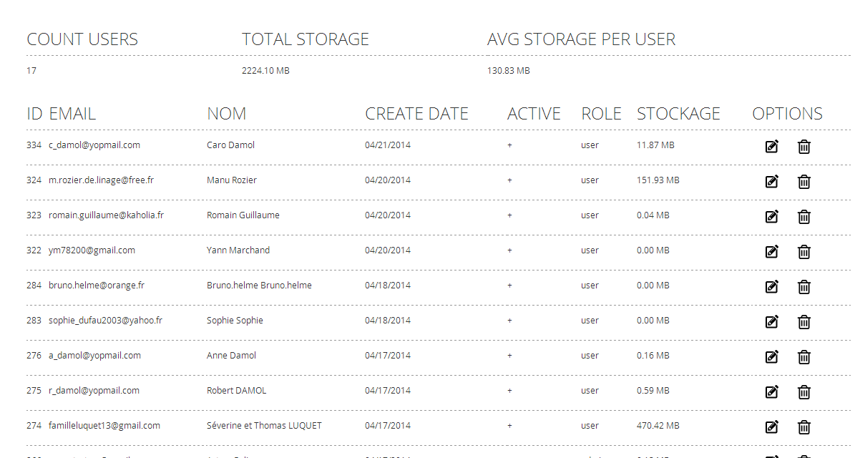
Reports
Storage capacity doesn’t match ??? Storage from report seems wrong.

Slide 11
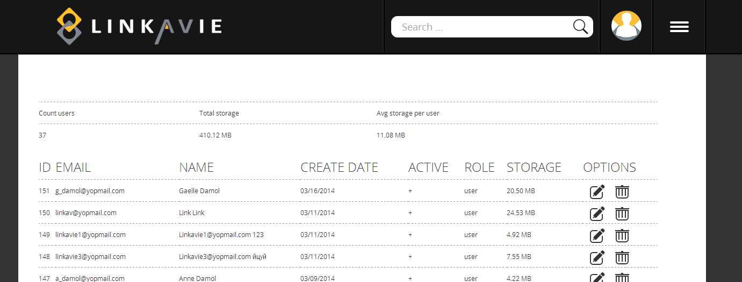
Reports
Warning message before delete:OK
But inside the warning popup, remind the email that is about to be deleted to avoid any mistake
Not updated accurately. Take cumulated storage, but don’t take into account when files are deleted.

Slide 12
Vault review

Slide 13
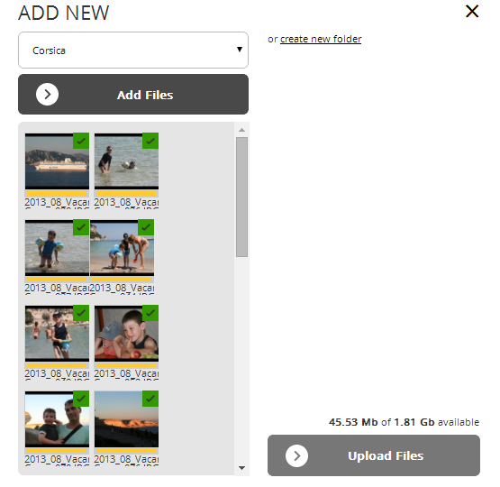

Vault: Uploader
Please use LINKAVIE green
Please use LINKAVIE green

Slide 14
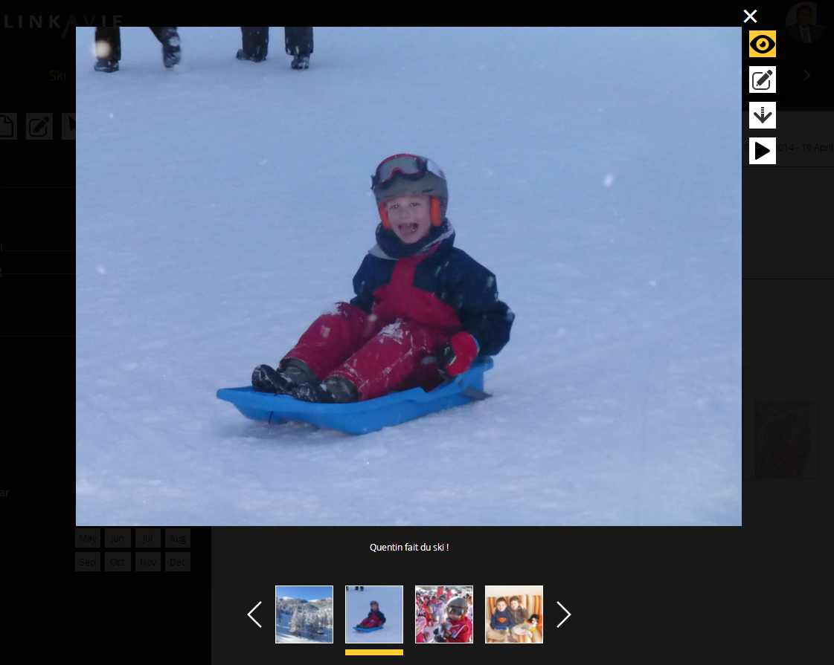
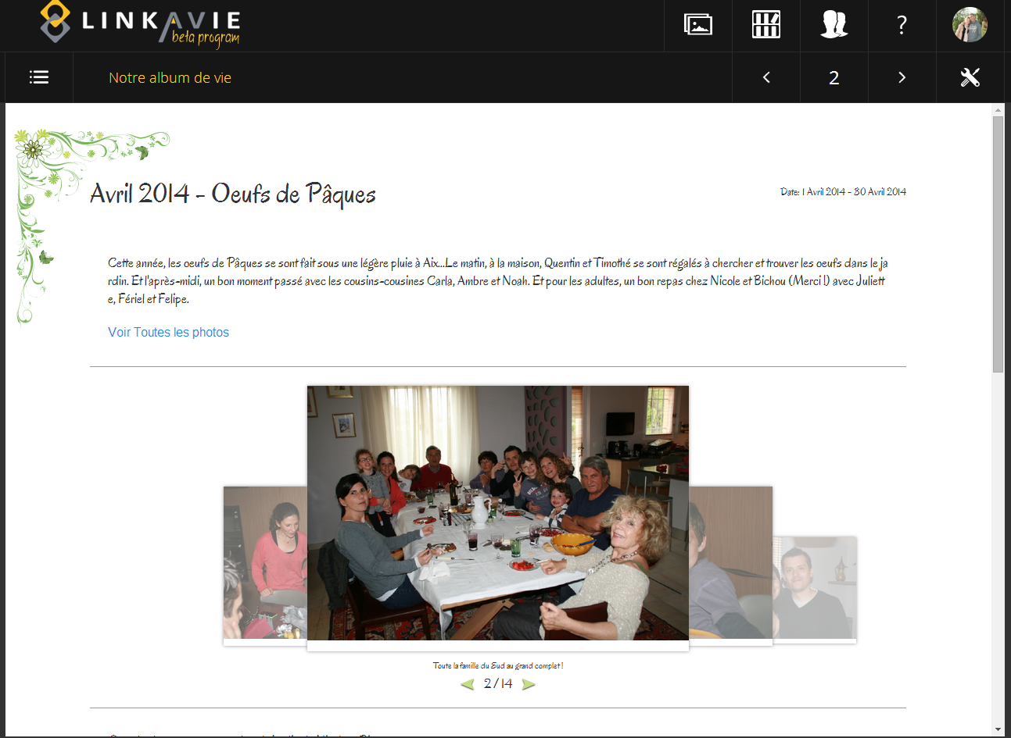
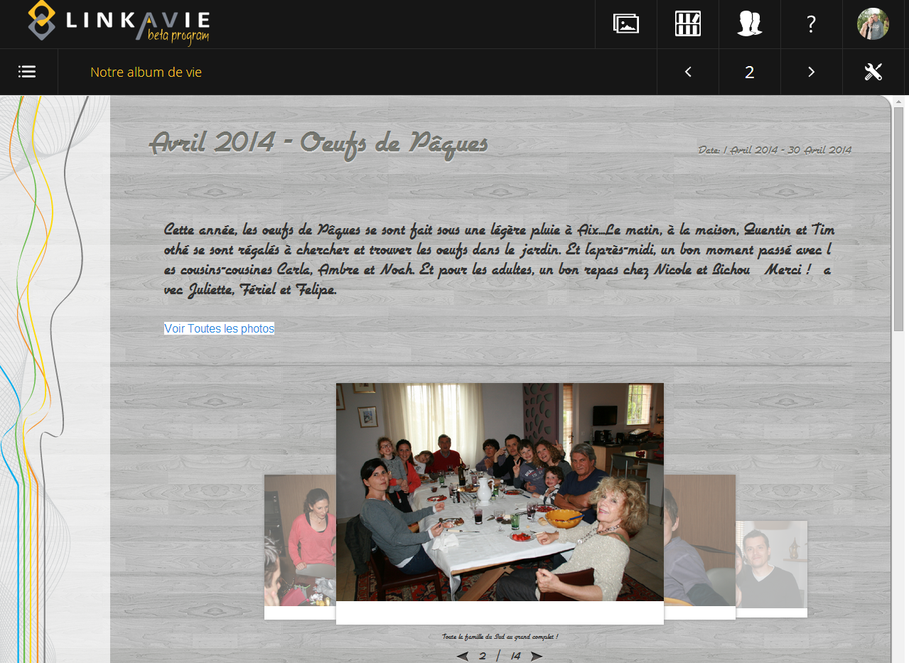
TO BE DONE
Picture description size still too small….Make Font size 16 maybe. How much is it now ?
In both themes Fresh Garden and Wooden Lines, picture description is more
Or less unreadable. Make it size =16

Slide 15
Digital Album
Excel ref: New sliding summary + Add year/months filters to the summary page and Library/
Features
New sliding summary
Albums infos: Album name on Library + Mouse over infos: M2
Album page 0 with sliding summary: M2
Horizontal fast sliding effect when navigating from page to page
Theme option (NEW):M2

Slide 16
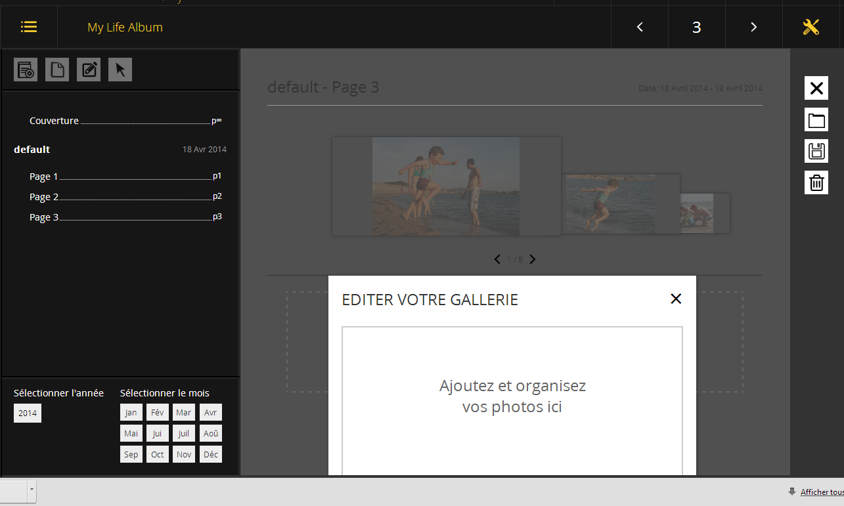
BUG: On 13’ laptop, sometimes I can’t access the buttons,
and can’t even scroll down
Also, when it works, buttons are not visible, which is not intuitive.

Slide 17
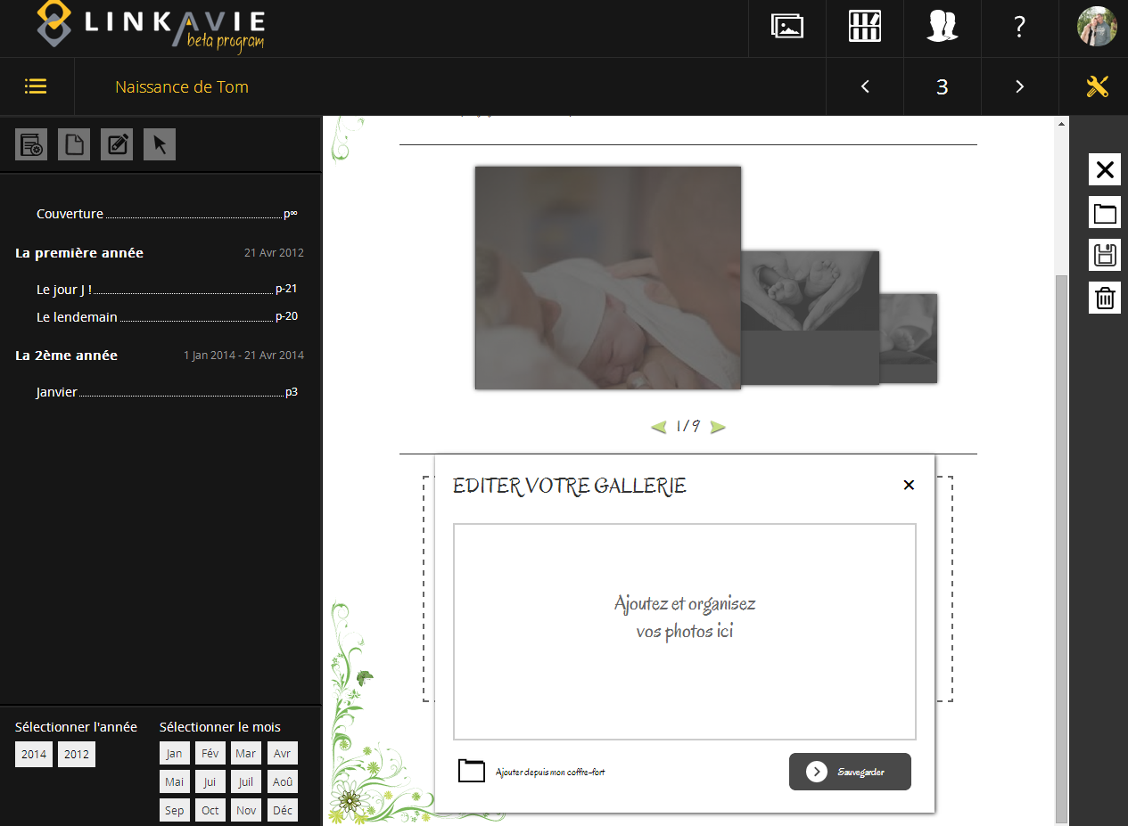
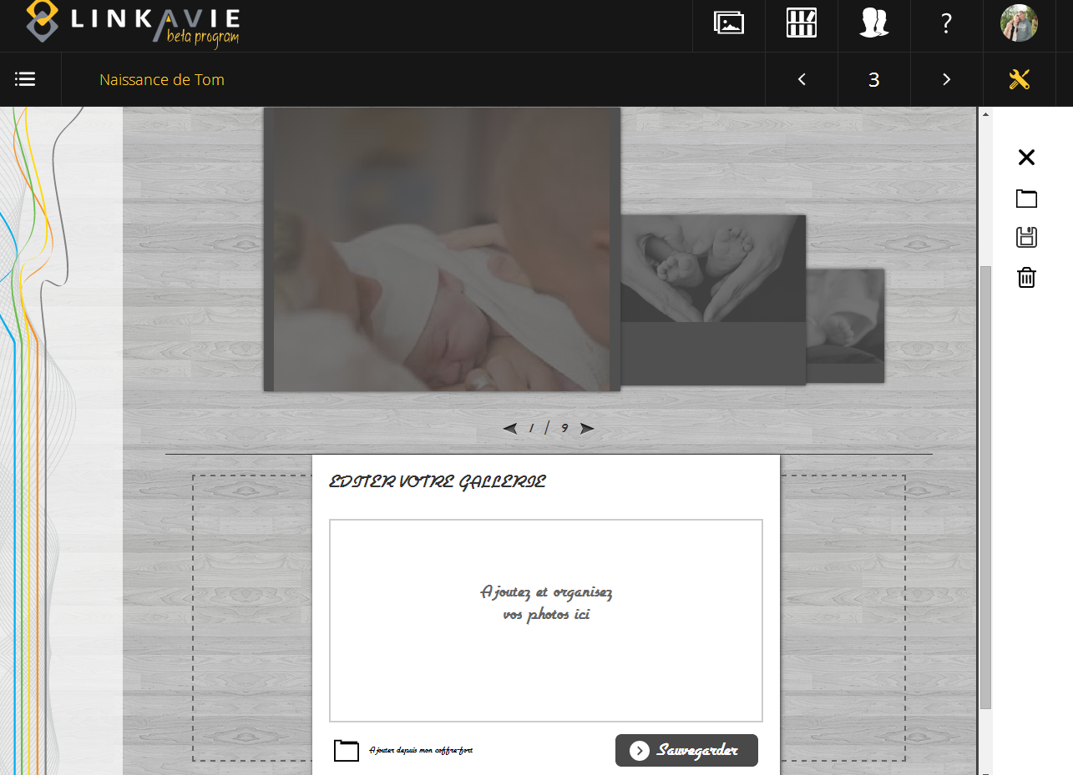
ADD Gallery / Edit gallery cosmetic
Too small for Fresh Garden and Wooden Lines: Put 16 Or for “Working/editing” windows, I would keep same font and size as Modern template

Slide 18
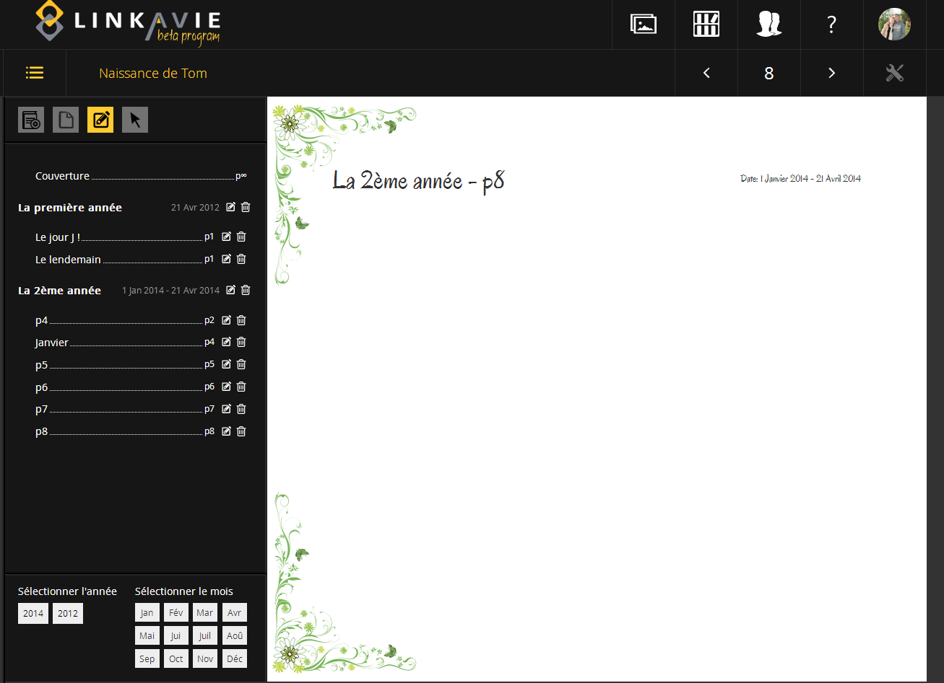
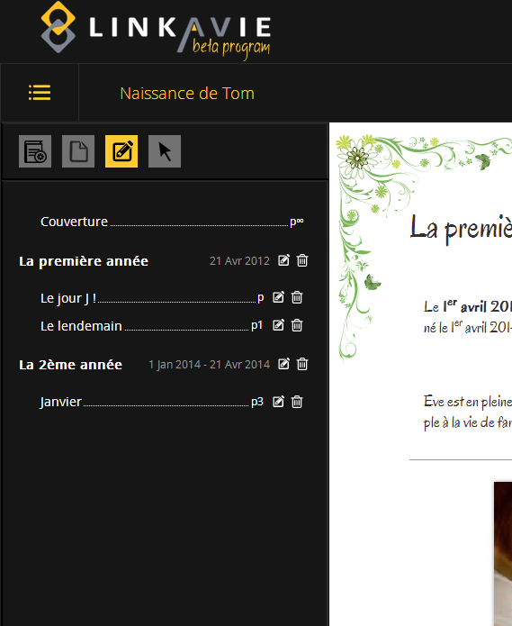
Pages numbering
Prio1: Page numbering still with bugs:
When moving pages, sometimes, need to double-click to access the page, simple click don’ work => Doing CTRLF5, then back to normal
Also page numbering went wrong: Difficult to reproduce, but you can go and see on www, familleluquet13@gmail.com / Quentim2007 and se album “Naissance de Tom”

Slide 19
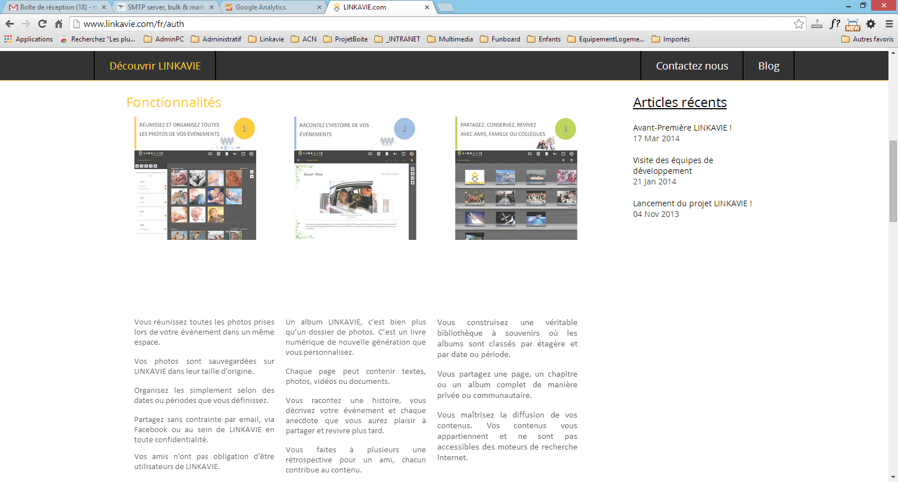
Framed-in Marketing:
Prio 1: Remove “Recent Articles” to make the page fresher
Why big blank here ?

Slide 20
END OF M1 tests – 21/04/2014

